Slide 1

FrameAnnotator
A frame-semantic annotation tool
Sarbajit Roy
M.S. Thesis, IDIR Lab
Supervising Professor
Dr. Chengkai Li
Committee Members
Dr. Ramez Elmasri
Dr. Deokgun Park
Master’s Thesis April 10, 2019

Slide 2
I would really like to dedicate my M.S. Thesis to my father.
This one is for you Baba!
Shyamal Roy
(1st May 1959 – 6th March 2016)

Slide 3
Outline
The importance of Fact-Checking
Motivation
Modeling Factual Claims with Frames
FrameNet
Challenges
FrameAnnotator
Definition
Understanding with an example
Live Demonstration
Questions?
References
Acknowledgement

Slide 4


The importance of Fact-checking
There is a struggle with……
Unprecedented amount of falsehoods,
Hyperboles and half-truths
Which do harm to wealth, democracy, health, and national security
https://ktwop.com/2017/11/03/will-recognition-of-fake-news-be-followed-by-fake-science/
In fighting against false information, the number of active fact-checking organizations has grown

Slide 5
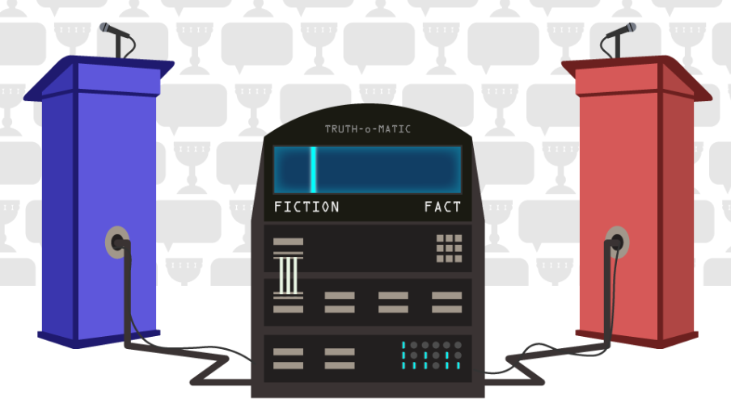
Motivation
Human based Fact-checking is hard :
Intellectually demanding,
Laborious,
Time-consuming
An opportunity for automated fact-checking systems
https://nordicapis.com/automated-fact-checking-the-holy-grail-of-political-communication/

Slide 6
Modeling Factual Claims with Frames
Increasing demands for fact-checking
growing interest in automating various fact-checking steps
Representing claims in a structured and semantic way will help to capture various aspects :
The domain and topic,
The expression of facts,
The entities involved and their relationships, quantities and many more
This claim modeling capability is useful for a variety of fact-checking steps

Slide 7
Modeling Factual Claims with Frames
The rank based on
Ranking entity
The rank
The U.S. only ranks 25th worldwide on defense spending as a percentage of GDP.
Predicate Sense: rank
Ranking entity: The U.S.
The rank: 25th
The rank comparison: worldwide
The rank based on: on defense spending…..
The rank comparison
Predicate
Meaning : stand, position, order

Slide 8
Modeling Factual Claims with Frames
Factual-claim specific frames
Collected fact-checked claims from PolitiFact,
Examined a subset of these claims one by one and grouped similar ones,
Created new frames, if it doesn’t already exist in FrameNet collection,
20 frames (13 newly created) and 900 labelled factual claims so far
Few examples of factual-claim specific frames
Oppose and support consistency,
Vote,
Correlation,
Occupy rank

Slide 9
FrameNet
FrameNet is a project housed at the International Computer Science Institute in Berkeley, California
A rich knowledge base that contains information about words by providing their description and associated frames,
A conceptual structure describing an event, relation, or object and the participants in it
The FrameNet lexical database contains over 1,200 semantic frames,
13,000 lexical units, and
202,000 example sentences
FrameNet has been used in applications like question answering, paraphrasing, information extraction, machine translation, and many more.

Slide 10
FrameNet
What is a Frame?
“Stand, top, rank”
All having a common-sense of background information
The holistic background knowledge that unites these words
A frame contains a textual frame definition, associated frame elements, lexical units, example sentences, and frame-to-frame relations

Slide 11
FrameNet
Frame Elements
Provide additional information to the semantic structure of a sentence
Types of Frame Elements:
core : Essential to the meaning of the frame
non-core : Generally descriptive (such as time, place, manner, etc.)
Lexical Units
Lexical units ( LU ) are lemmas , with their POS , that evoke a specific frame
Lexical units that suggest the Occupy_rank frame include the words “rank", “stand", and “top“
Frame-to-frame relations
Relationships between different frames
Some relations are subframe, inheritance, Perspectivized_in and so on

Slide 12





Modeling Factual Claims with Frames
Understanding an example with Occupy_rank frame
Under Gov. Mitt Romney , Massachusetts ranked 47th in job creation .
LU
Under Gov. Mitt Romney , Massachusetts ranked 47th in job creation .
LU
Under Gov. Mitt Romney, Massachusetts ranked 47th in job creation .

Slide 13
Modeling Factual Claims with Frames
LU
Under Gov. Mitt Romney, Massachusetts ranked 47th in job creation .
LU
Under Gov. Mitt Romney, Massachusetts ranked 47th in job creation .

Slide 14
Modeling Factual Claims with Frames
LU
Under Gov. Mitt Romney, Massachusetts ranked 47th in job creation .
Under Gov. Mitt Romney , Massachusetts ranked 47th in job creation .
Core : Dimension – Along which the ranking is defined, Item –In which occupies the rank Rank - In which the item occupies | Non-Core : Comparison_set - Comparison among the entities Time – Time over which the item occupies the rank

Slide 15






Modeling Factual Claims with Frames
Understanding an example with Vote frame
Mitch MacConnell voted two times against the violence Against Women Act .
LU
Mitch MacConnell voted two times against the violence Against Women Act .
LU
Mitch MacConnell voted two times against the violence Against Women Act .

Slide 16

Challenges
The current state-of-the-art frame semantic parsers suffer from lack of a large labeled dataset,
Manual labeling of data is time consuming, and
There are no open-source annotation tools available
To overcome all those challenges we developed the idea of

Slide 17
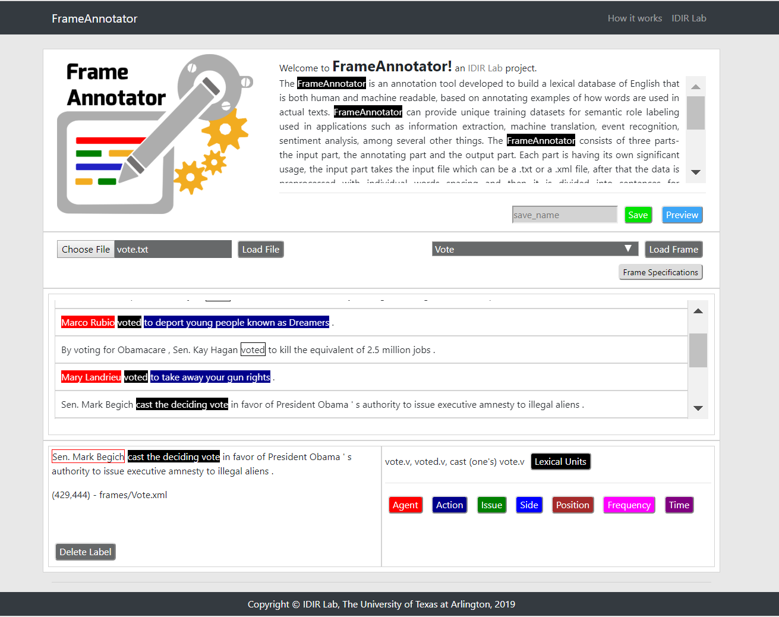
FrameAnnotator
A web-based public frame semantic annotation tool

Slide 18
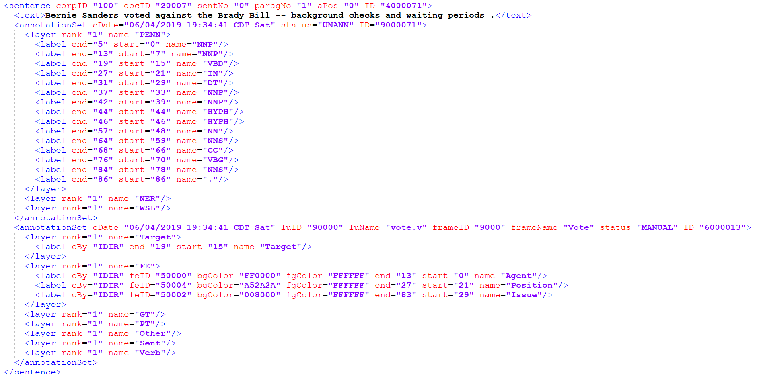
FrameAnnotator
It allows users to create frame-semantic datasets and codify sentences

Slide 19

FrameAnnotator
Understanding with an example - Frame Name : Vote
Bernie Sanders voted against the Brady Bill -- background checks and waiting periods .
Bernie Sanders voted against the Brady Bill -- background checks and waiting periods .
Bernie Sanders voted against the Brady Bill -- background checks and waiting periods .

Slide 20
FrameAnnotator
Understanding with an example - Frame Name : Vote

Slide 21
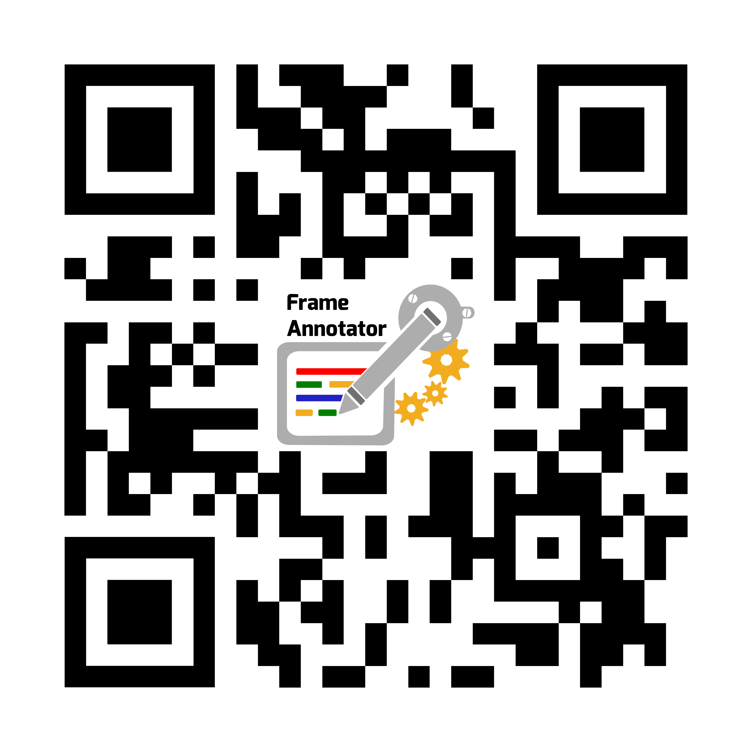
Demonstration
https://idir.uta.edu/frameannotator/

Slide 22
Questions ?

Slide 23
References
Hassan, Naeemul, et al. "Toward automated fact-checking: Detecting check-worthy factual claims by ClaimBuster." Proceedings of the 23rd ACM SIGKDD International Conference on Knowledge Discovery and Data Mining. ACM, 2017.
Baker, Collin F., Charles J. Fillmore, and John B. Lowe. "The berkeley framenet project." Proceedings of the 17th international conference on Computational linguistics-Volume 1. Association for Computational Linguistics, 1998.
Wu, You, et al. "Toward computational fact-checking." Proceedings of the VLDB Endowment 7.7 (2014): 589-600.
Fillmore, Charles J., Christopher R. Johnson, and Miriam RL Petruck. "Background to framenet." International journal of lexicography 16.3 (2003): 235-250.
en.wikipedia.org/wiki/FrameNet
framenet.icsi.berkeley.edu/fndrupal/
aclweb.org/anthology/N16-1019
www.techopedia.com/why-is-data-annotation-important-in-some-machine-learning-projects/7/33331
appen.com/why-human-annotated-data-key/
web.stanford.edu/~jurafsky/slp3/slides/22_SRL.pdf
web.stanford.edu/~jurafsky/slp3/18.pdf

Slide 24
Acknowledgement
Supervising Professor
Dr. Chengkai Li
Committee Members
Dr. Ramez Elmasri
Dr. Deokgun Park
My aunt Anita Dutta & Anima Dutta, my mom Gita Roy, my aunt Champa Paul my brother Satadru Roy, my sister-in-law Swati Roy
IDIR-mates : Farahnaz, Fatma, Israa, Damian, Shadek, Sami, Xiao, Dora, Zeyu, Priyank, Sarthak, Daniel, Sumeet, Kyrell and Jacob
My people : Adityo, Santra, Daipayan, Jeson, Harman, Kena, Shashank, Toor, Suraj, Pradeep, Subharag Gaurav, Arunabho, Shrijay, Pankaj, Saikat, Souvik, Supriyo, UTA CoLA and full UTA Cricket team

Slide 25
Thank you!

